Slide 1
Data Structures so far...
Array is a good static data structure that can be accessed randomly and is fairly easy to implement.
Linked Lists on the other hand is dynamic and is ideal for application that requires frequent operations such as add, delete, and update.
One drawback of linked list is that data access is sequential.
Notes:
Then there are other specialized data structures like, stacks and queues that allows us to solve complicated problems using these restricted data structures.

Slide 2
Disadvantage of sequential data structures:
Time to search is directly proportional to data in data structure.
Therefore it seems that more efficient data structures are needed to store and search data.
Notes:
For example, if the size of the data set is n, then the number of comparisons needed to find an item may be as bad as some multiple of n.*
* So imagine doing the search on a linked list (or array) with n = 106 nodes. Even on a machine that can do million comparisons per second, searching for m items will take roughly m seconds. This not acceptable in today’s world where speed at which we complete operations is extremely important.

Slide 3
Trees
Tree is a hierarchical data structure which stores the information naturally in the form of hierarchy style.
It represents the nodes connected by edges.
A tree is a nonlinear data structure.
Notes:
We can extend the concept of linked data structure (linked list, stack, queue) to a structure that may have multiple relations among its nodes. Such a structure is called a tree.

Slide 4
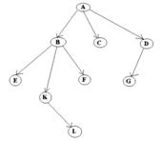
General Properties of Trees
One node is distinguished as a root
Every node (except root) is connected by a directed edge from exactly one other node. A direction is: parent -> children
Here, A is a parent of B, C, D,
B is called a child of A.
on the other hand, B is a parent of E, F, K

Slide 5
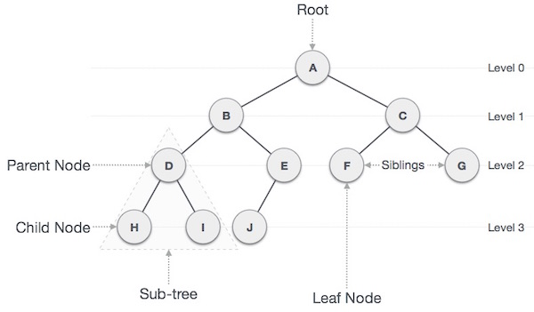
General Terms of Trees
Keys
Visiting
Traversing
Notes:
*Internal nodes have at least one child.

Slide 6
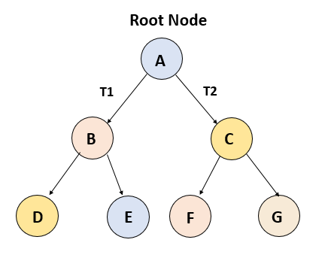
Types of Trees
General Tree:
No constraint on hierarchy of tree.
Every node may have infinite numbers of children.
Binary Tree:
Each node can have at max two child nodes.
This is more popular than most other trees.

Slide 7
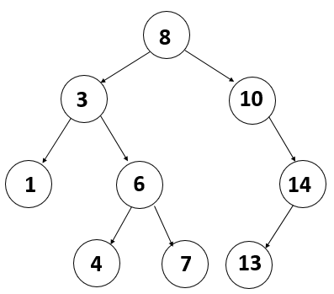
Types of Trees
Binary Search Tree:
Extension of Binary Tree
Value of left child should be less than or equal to the parent value for each node.
Value of right child should be greater than or equal to the parent value for each node.
Ideal for search operations.

Slide 8
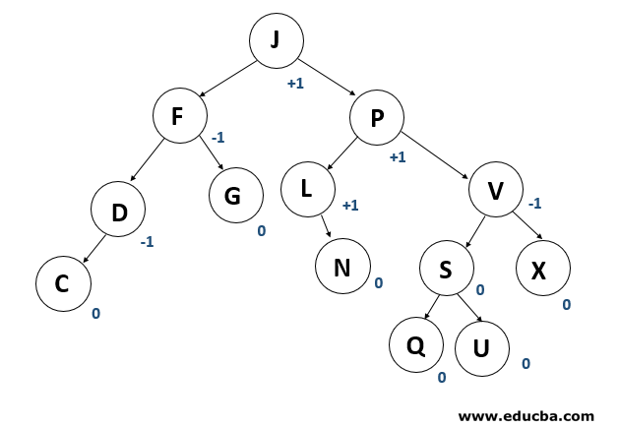
Types of Trees
AVL Trees
AVL tree is a binary search tree self-balancing.
A balancing factor is allocated for each node in the AVL tree, based on whether the tree is balanced or not.
The correct balance factor is either 1, 0 and -1.
If new node is added, then it will be rotated to ensure that the tree is balanced.

Slide 9
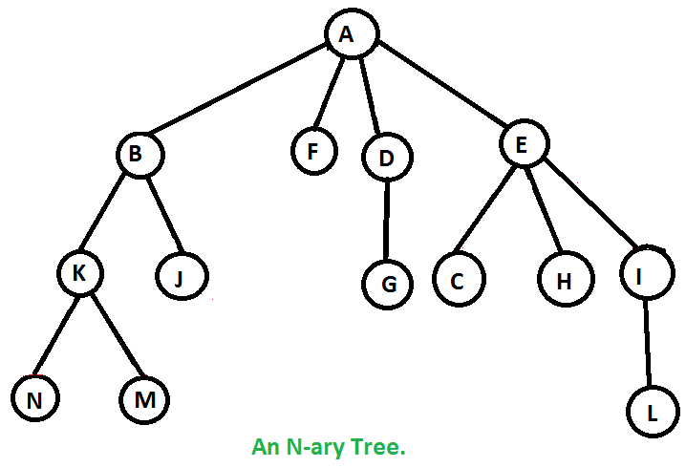
Types of Trees
N-ary Trees:
The maximum number of child nodes a parent node can have is N.
Similar to Binary tree

Slide 10
Basic Operations
Insertion - Inserting a new node.
Searching - Searching for a specific node
Traversal - Traversing the tree
Deletion - Deleting a node

Slide 11
Applications
Storing naturally hierarchical data. E.g: filesystems
Organizing data for quick search, insertion, deletion. E.g: Binary Search Trees.
Network Routing Algorithms
And much more ....

Slide 12
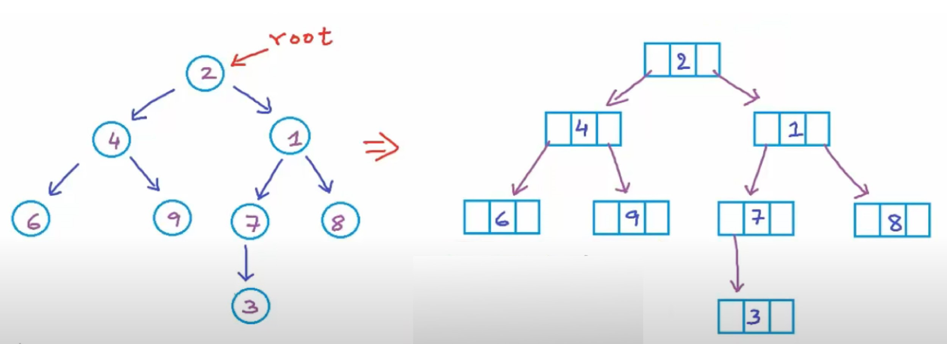
Representation
(Binary Trees)
struct Node {
int data;
Node* left;
Node* right;
};

Slide 13
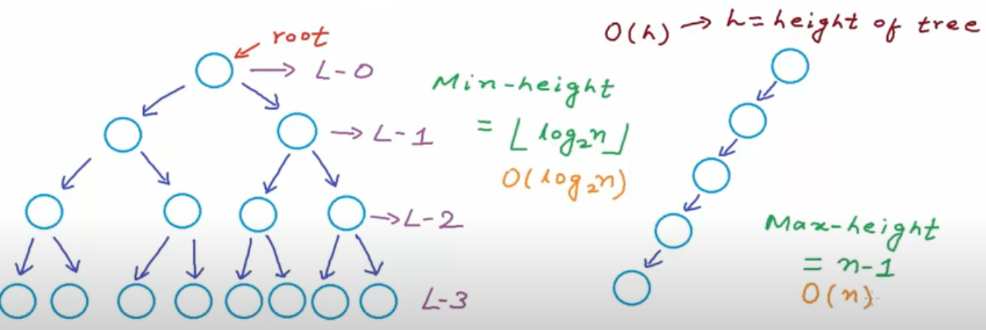
Complexity
(Binary Trees)

Slide 14
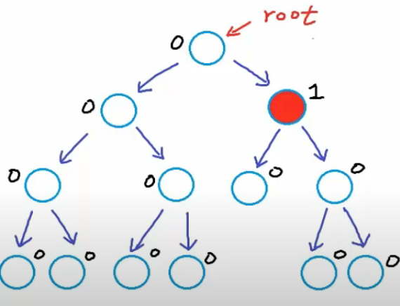
Balanced Binary Tree
For every node,
Difference between height of left and right subtree is not more than K (mostly 1).
Height of Tree:
No. of edges in longest path from root node to leaf node.
Diff = | h_{left} - h_{right} |
Height of empty tree = -1
Height of tree with one node = 0

Slide 15
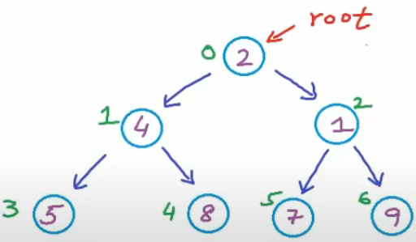
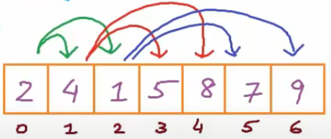
Implementation
(Binary Tree)
Binary Trees can be implemented using:
Dynamically created nodes
Arrays
struct Node {
int data;
Node* left;
Node* right; };
For node at index i,
Left-child-index = 2i+1
Right-child-index = 2i+2
In a complete binary tree

Slide 16
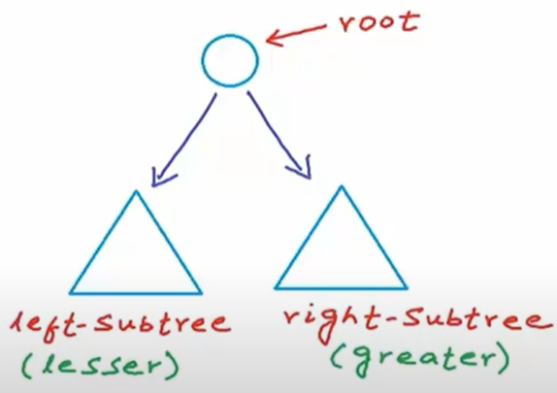
Representation
(Binary Search Tree)
Binary Search Tree (BST)
A binary tree in which for each node, values of all the nodes in left subtree is lesser or equal and the values of all the nodes in right subtree is greater.
left-subtree (keys) ≤ node (key) ≤ right-subtree (keys)

Slide 17
Implementation in C++
(Binary Search Tree)
#include<iostream>
using namespace std;
struct BstNode {
int data;
BstNode* left;
BstNode* right;
};
int main(){
BstNode* root; //pointer to root node
root = Null; //setting tree as empty
}
Creating an empty tree using this c++ code.
Structure definition of a node of tree.
Creating a node pointer and pointing that to null value to create an empty tree with root node pointing to null.

Slide 18
Implementation in C++
(Binary Search Tree) - Insert Operation
BstNode* GetNewNode(int data){
BstNode newNode = new BstNode();
newNode->data = data;
newNode->left = newNode->right = NULL;
return newNode;
}
BstNode* Insert(BstNode* root, int data){
if(root == NULL){ //empty tree
root = GetNewNode(data); }
else if(data <= root->data){
root->left = Insert(root->left, data); }
else{
root->right = Insert(root->right, data); }
return root;
}
Function to create a new node.
Function to insert the node in the tree based on different conditions.

Slide 19
Implementation in C++
(Binary Search Tree) - Search Operation
bool Search(BstNode* root, int data){
if (root == NULL) return false;
else if(root->data == data) return true;
else if(root->data <= data) return Search(root->left, data);
else return Search(root->right, data);
}
Function to search for data in tree and return bool value.

Slide 20
Implementation in C++
(Binary Search Tree) - Main Function
int main(){
BstNode* root = NULL //creating an empty tree
root = Insert(root, 15); root = Insert(root, 10); root = Insert(root, 20);
root = Insert(root, 25); root = Insert(root, 8); root = Insert(root, 12);
int number;
cout<<”Enter the number to be searched\n”;
cin>>number;
if(Search(root, number) == true) cout<<”Found\n”;
else cout<<”Not Found\n”;
}

Slide 21
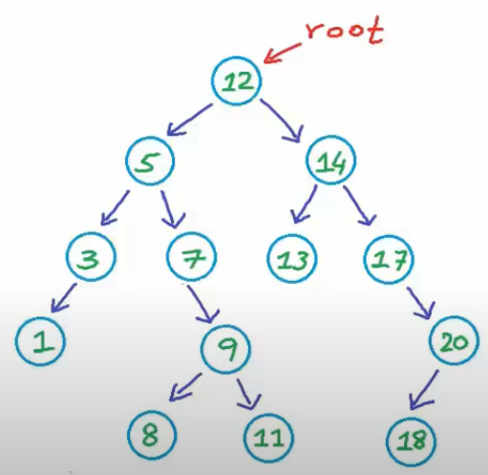
Delete Operation
(Binary Search Tree)
Case1: No Child
Case2: One Child
Case3: Two Children
Find minimum node in right;
Copy the value in targeted node;
Delete duplicate from right-subtree;
Find maximum node in left;
Copy the value in targeted node;
Delete duplicate from left-subtree;

Slide 22
Implementation in C++
(Binary Search Tree) - Delete Operation
BstNode* Delete(BstNode* root, int data){
if (root == NULL) return root;
else if(data < root->data) root->left = Delete(root->left, data);
else if(data> root->data) root->right = Delete(root->right, data);
else{//found the node to be deleted
//code to delete the node and rearrange the
//remaining nodes in different cases.
}
return root;
}

Slide 23
Implementation in C++
(Binary Search Tree) - Delete Operation
{//logic continued
if(root->left == NULL && root->right == NULL){
//Case1: No child
delete root;
root = NULL;
}
//other cases
}

Slide 24
Implementation in C++
(Binary Search Tree) - Delete Operation
//logic continued
//Case2 : One Child
//no left subtree
else if(root->left == NULL){
BstNode* temp = root;
root = temp->right;
delete temp;
}
//no right subtree

Slide 25
Implementation in C++
(Binary Search Tree) - Delete Operation
else if(root->right == NULL){
BstNode* temp = root;
root = temp->left;
delete temp;
}
else{ //Case 3: Two children
BstNode* temp = FindMin(root->right);
root->data = temp->data;
root->right = Delete(root->right, temp->data);
}
}
This function returns the node with minimum value in that subtree.

Slide 26
Traversal Operations
(Binary Search Tree)
Breadth First Traversal (or Level Order Traversal)
Depth First Traversals
Preorder Traversal (Root-Left-Right)
Inorder Traversal (Left-Root-Right)
Postorder Traversal (Left-Right-Root)
NOTE: In all the above traversals, we visit every node exactly once. This costs:
O(n) time complexity
O(h) space complexity(for Depth first traversals) (for Breadth First Traversal)
in worst case: O(n) in worst/average case: O(n)
In best/average case: O(logn) in best case: O(1)

Slide 27
Implementation in C++
(Binary Search Tree) - Traversal
Preorder Traversal:
Until all nodes are traversed:
Step1: Visit Root Node
Step2: Recursively traverse left subtree.
Step3: Recursively traverse right subtree.
Code:
void preorder(BstNode* root){
if (root != NULL){
cout<<root->data<<" ";
preorder(root->left);
preorder(root->right);
}
}
Time Complexity: O(n)
Space Complexity: O(h)

Slide 28
Implementation in C++
(Binary Search Tree) - Traversal
Inorder Traversal:
Until all nodes are traversed:
Step1: Recursively traverse left subtree.
Step2: Visit Root Node
Step3: Recursively traverse right subtree.
Code:
void inorder(BstNode* root){
if (root != NULL){
inorder(root->left);
cout<<root->data<<" ";
inorder(root->right);
}
}
Time Complexity: O(n)
Space Complexity: O(h)

Slide 29
Implementation in C++
(Binary Search Tree) - Traversal
Postorder Traversal:
Until all nodes are traversed:
Step1: Recursively traverse left subtree.
Step2: Recursively traverse right subtree.
Step3: Visit Root Node
Code:
void postorder(BstNode* root){
if (root != NULL){
postorder(root->left);
postorder(root->right);
cout<<root->data<<" ";
}
}
Time Complexity: O(n)
Space Complexity: O(h)

Slide 30
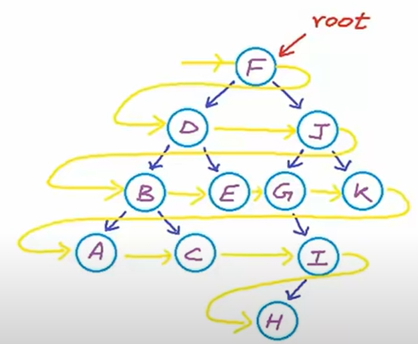
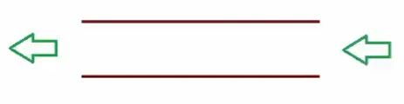
Implementation in C++
(Binary Search Tree) - Level Order Traversal
void LevelOrder(BstNode* root){
if (root == NULL)return;
queue<BstNode*> Q;
Q.push(root);
//while there is at least one discovered node
while(!Q.empty()){
BstNode* current = Q.front();
cout<<current->data<<” “;
if(current->left !=NULL) Q.push(current->left);
if(current->right !=NULL) Q.push(current->right);
Q.pop(); } //removing the element at front
}
Level Order: F, D, J, B, E, G, K, A, C, I, H
Can implement using Queue (FIFO)

Slide 31
Program
Given a binary tree, check whether the binary tree is a Binary Search Tree (BST) or not.

